Slide 1
Homework
Week 10

Slide 2
Questions 1-12
1. 3 and 6
2. 5hrs and 35mins
3. $1200 x 80% = $960
4. 4 x 3 + 5 = 17
5. 5.6 x 20 = 112km, C
6. A
7. A
8. B
9. C
10. D
11. ⅟32
12. 1331

Slide 3

Question 13
What is the value of z?
Angle = 180° - 125°
= 55°
z = 55° + 49°
= 104°
ANSWER = 104°

Slide 4
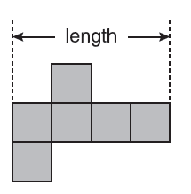
Question 14
This is a net of a cube. The cube has a volume of 343 cubic millimetres. What is the length of the net in millimetres?
Length of cube =
= 7 mm
Length of net = 7 x 4
= 28mm
Answer = 28mm

Slide 5

Question 15
The average height of six netball players is 1.75 metres. A seventh player is 1.61 metres tall. What is the average height of the seven players?
Sum of 6 heights = 1.75 x 6
= 10.5 m
Average height of 7 players = (10.5 + 1.61) ÷ 7
= 1.73 m
Answer = 1.73m

